Slide 1

Getting started
Tech Club(GNIOT)

Slide 2
Sample Class
public Sample {
public static void main(String[] args) {
System.out.println("Hello World");
}
}
public - access Modifier
class - keyword used to define a new class.
Sample -class name.
main - The function to be executed when the program runs.

Slide 3
Java Comments
Comments can be used to explain Java code, and to make it more readable. It can also be used to prevent execution when testing alternative code.
Single Line Comment ( // this is comment ).
Multi Line Comment ( /* this is comment */ ).
Any text after // or between /**/ is ignored by Java Compiler i.e. (will not be executed).
// This is a comment
System.out.println("Hello World");
/* This is multi-
line comment */

Slide 4
Java Variables
Variables are containers for storing data values.
In Java, there are different types of variables, for example:
int - stores integers (whole numbers), without decimals, such as 123 or -123
float - stores floating point numbers, with decimals, such as 19.99 or -19.99
char - stores single characters, such as 'a' or 'B'. Char values are surrounded by single quotes
boolean - stores values with two states: true or false
String - stores text, such as "Hello". String values are surrounded by double quotes

Slide 5
Variable Declaration
public class Main{
public static void main(String[] args){
int myNum = 5;
float myFloatNum = 5.99f;
char myLetter = 'D’;
boolean myBool = true;
String myText = "Hello";
// Print all the variables to see their values
System.out.println(myNum+myFloatNum+myLetter+myBool+myText);
}
}

Slide 6
Java Type Casting
Type casting is when you assign a value of one primitive data type to another type.
In Java, there are two types of casting:
Widening Casting (automatically) - converting a smaller type to a larger type size
byte -> short -> char -> int -> long -> float -> double
Narrowing Casting (manually) - converting a larger type to a smaller size type
double -> float -> long -> int -> char -> short -> byte

Slide 7
Widening Casting
public class Main {
public static void main(String[] args) {
int myInt = 9;
double myDouble = myInt; // Automatic casting: int to double
System.out.println(myInt); // Outputs 9
System.out.println(myDouble); // Outputs 9.0
}
}

Slide 8
Narrowing Casting
public class Main {
public static void main(String[] args) {
double myDouble = 9.78;
int myInt = (int) myDouble; // Manual casting: double to int
System.out.println(myDouble); // Outputs 9.78
System.out.println(myInt); // Outputs 9
}
}

Slide 9
Java If ... Else
Java supports the usual logical conditions from mathematics:
Less than: a < b
Less than or equal to: a <= b
Greater than: a > b
Greater than or equal to: a >= b
Equal to a == b
Not Equal to: a != b
if (condition1) {
// block of code to be executed if condition1 is true
} else if (condition2) {
// block of code to be executed if the condition1 is false and condition2 is true
} else {
// block of code to be executed if the condition1 is false and condition2 is false
}

Slide 10
Java Arrays
Arrays are used to store multiple values in a single variable, instead of declaring separate variables for each value.
To declare an array, define the variable type with square brackets:
DataType [] variableName = {element1, element2, element3};
DataType [] variableName = new DataType[sizeOfTheArray];
Important methods of Arrays –
length – returns the length of the Array.
String[] cars = {"Volvo", "BMW", "Ford", "Mazda"};
for (int i = 0; i < cars.length; i++) {
System.out.println(cars[i]);
}

Slide 11
Java Strings
Strings are nothing but sequence of characters and it is used for storing text.
A String variable contains a collection of characters surrounded by double quotes:
Syntax:- 1. String myName = “Deepak”;
2. String myName = new String(“Deepak”);
Important methods of Strings –
length() – returns the length of string.
equals(stringToCompare) – return Boolean value (True if both Strings are equal or False if both Strings are unequal).
charAt(index) – returns the character at the given index.
substring(startingIndex, endingIndex+1) – returns the String from staring to ending index.
toUpperCase() – returns the uppercase representation of the string.
toLowerCase() – returns the lowercase representation of the string.

Slide 12
Java Methods
A method is a block of code which only runs when it is called.
You can pass data, known as parameters, into a method.
Methods are used to perform certain actions, and they are also known as functions.
Why use methods? To reuse code: define the code once, and use it many times.
public class Main {
static void myMethod() {
System.out.println("I just got executed!");
}
public static void main(String[] args) {
myMethod();
}
}

Slide 13
Parameters and Arguments
Information can be passed to methods as parameter. Parameters act as variables inside the method.
Parameters are specified after the method name, inside the parentheses. You can add as many parameters as you want, just separate them with a comma.
The following example has a method that takes a String called fname as parameter. When the method is called, we pass along a first name, which is used inside the method to print the full name:
public class Main {
static void myMethod(String fname) {
System.out.println(fname + " Refsnes");
}
public static void main(String[] args) {
myMethod("Liam");
myMethod("Jenny");
myMethod("Anja");
}
}

Slide 14
OOPS

Slide 15
What is OOP?
OOP stands for Object-Oriented Programming.
Procedural programming is about writing procedures or methods that perform operations on the data, while object-oriented programming is about creating objects that contain both data and methods.
Object-oriented programming has several advantages over procedural programming:
OOP is faster and easier to execute
OOP provides a clear structure for the programs
OOP helps to keep the Java code DRY "Don't Repeat Yourself", and makes the code easier to maintain, modify and debug
OOP makes it possible to create full reusable applications with less code and shorter development time

Slide 16
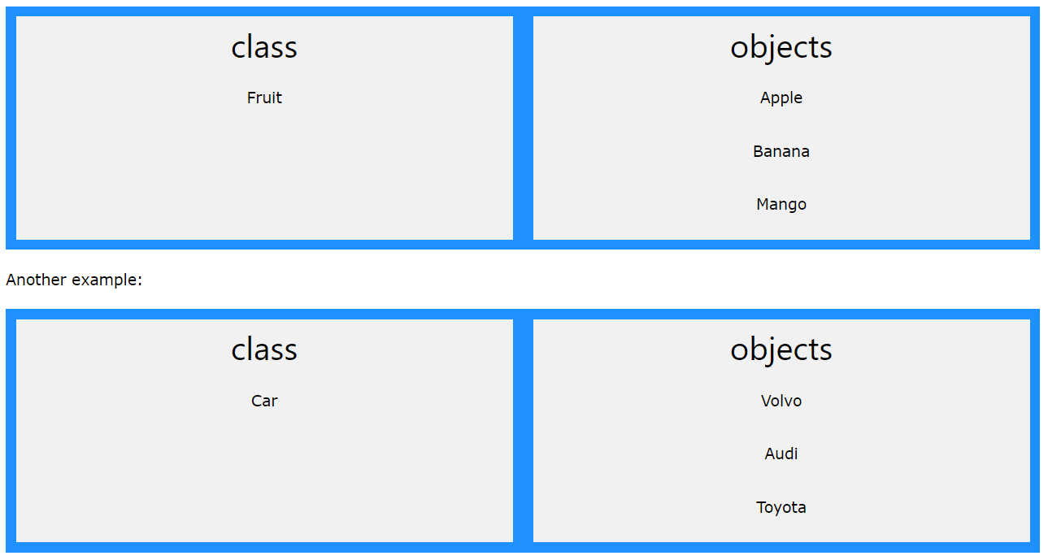
Classes and Objects

Slide 17
Java Classes and Objects
Java is an object-oriented programming language.
Everything in Java is associated with classes and objects, along with its attributes and methods. For example: in real life, a car is an object. The car has attributes, such as weight and color, and methods, such as drive and brake.
A Class is like an object constructor, or a "blueprint" for creating objects.
public class Main {
int x = 5;
public static void main(String[] args) {
Main myObj = new Main();
System.out.println(myObj.x);
}
}

Slide 18
Java Constructors
A constructor in Java is a special method that is used to initialize objects. The constructor is called when an object of a class is created. It can be used to set initial values for object attributes:
public class Main {
int modelYear;
String modelName;
public Main(int year, String name) {
modelYear = year;
modelName = name;
}
public static void main(String[] args) {
Main myCar = new Main(1969, "Mustang");
System.out.println(myCar.modelYear + " " + myCar.modelName);
}
}

Slide 19
Java Modifiers
The public keyword is an access modifier, meaning that it is used to set the access level for classes, attributes, methods and constructors.
We divide modifiers into two groups:
Access Modifiers - controls the access level
Non-Access Modifiers - do not control access level, but provides other functionality

Slide 20
Access Modifiers
For classes, you can use either public or default:
Public - The class is accessible by any other class
Default - The class is only accessible by classes in the same package. This is used when you don't specify a modifier.
For attributes, methods and constructors, you can use the one of the following:
Public - The code is accessible for all classes
Private - The code is only accessible within the declared class
Default - The code is only accessible in the same package. This is used when you don't specify a modifier.
Protected - The code is accessible in the same package and subclasses.

Slide 21
Non-Access Modifiers
For classes, you can use either final or abstract:
Final - The class cannot be inherited by other classes.
Abstract - The class cannot be used to create objects (To access an abstract class, it must be inherited from another class.
For attributes and methods, you can use the one of the following:
Final - Attributes and methods cannot be overridden/modified
Static - Attributes and methods belongs to the class, rather than an object
Abstract - Can only be used in an abstract class, and can only be used on methods. The method does not have a body, for example abstract void run();. The body is provided by the subclass (inherited from).
transient - Attributes and methods are skipped when serializing the object containing them
Synchronized - Methods can only be accessed by one thread at a time
Volatile - The value of an attribute is not cached thread-locally, and is always read from the "main memory"

Slide 22
Java Encapsulation
The meaning of Encapsulation, is to make sure that "sensitive" data is hidden from users.
To achieve this, you must:
declare class variables/attributes as private
provide public get and set methods to access and update the value of a private variable

Slide 23
Get and Set
The get method returns the variable value, and the set method sets the value.
Syntax for both is that they start with either get or set, followed by the name of the variable, with the first letter in upper case:
public class Person {
private String name; // private = restricted access
// Getter
public String getName() {
return name;
}
// Setter
public void setName(String newName) {
this.name = newName;
}
}

